Slide 1


Unit 7 Assignment
Aron Alley Purdue University Global IT Integrative Project – IT 299 Professor Rantisi 01/13/2026
Golden Hour studios
A photography
Website
Notes:
Welcome, everyone, to the Product Review Meeting for Golden Hour Studios. Today, we will walk through the progress made so far, highlight completed work, and discuss items in progress. The goal is to provide a clear snapshot of where we are in the project timeline. Thank you all for joining.

Slide 2
Product Review Meeting | Introduction
Project overview and objectives
Timeline highlights and current phase
Key stakeholders and team roles
Notes:
This slide introduces the project scope and its primary objectives. We will review the overall timeline, noting the current phase of development and testing. Key stakeholders are identified, and team roles are clarified to ensure accountability and clear communication throughout the project. This sets the context for understanding the status updates and progress reports in the following slides.

Slide 3
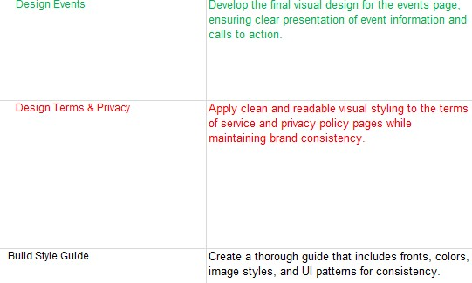
Updated Work Breakdown Structure Overview
Comprehensive WBS reflecting new tasks and progress
Color-coded status indicators for clarity
Status descriptions explain any delays or schedule variance
Notes:
The WBS has been fully updated to capture all project tasks, including design, UI development, testing, and deployment. Each task is color-coded to indicate current progress, helping stakeholders quickly identify completed work versus tasks in progress. Notes for each task provide explanations for delays or extended durations, offering transparency for project management decisions.

Slide 4

Requirement Analysis
Stakeholders identified and requirements gathered
Interviews conducted for in-depth insights
Webpages and branding requirements documented
Notes:
All requirements analysis tasks have been completed successfully. Stakeholders were identified, and interviews captured functional, technical, and visual needs for the website. Additionally, we determined the necessary webpages and documented visual branding requirements, making sure we have a solid foundation for wireframes and UI design.

Slide 5
Wireframes
Wireframes created for all main webpages
Layouts approved for navigation, content, and CTAs
Adjustments made based on feedback and downstream dependencies
Notes:
Wireframes have been deployed for all core pages (Home, Gallery, Contact, About, Packages/Pricing, Bookings, Testimonials/Reviews, Terms & Privacy, and Cart). Each wireframe was reviewed and approved, ensuring a consistent layout and clear navigation. Minor schedule adjustments were made to accommodate dependencies, but they did not impact overall progress.

Slide 6

Visual UI Designs
Homepage, Gallery, Contact, About, Packages/Pricing completed
Cart, Testimonials/Reviews, and Terms & Privacy in progress
Style guide initiated for consistent branding
Notes:
UI designs for the highest-priority pages are complete and aligned with branding guidelines. Some pages are still in progress due to schedule adjustments, but work is underway. A style guide is being built to maintain consistency across all visual elements like typography, colors, and component layouts.

Slide 7
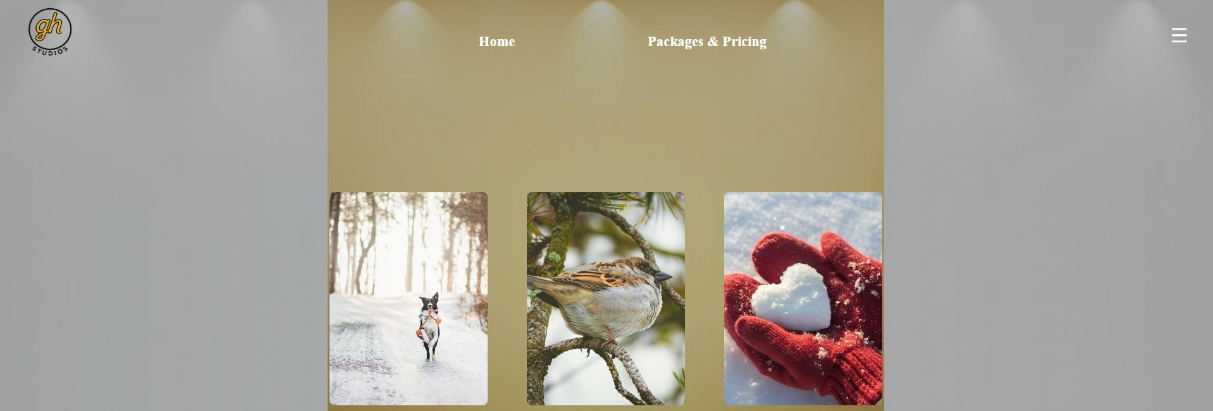
UI Development Progress
Core UI pages implemented
Bookings page completed
Testimonials/Reviews, Terms & Privacy pending
Development tracked against WBS with color-coded progress
Notes:
Website UI implementation is progressing according to the WBS. Core pages are complete, and the bookings page has been implemented successfully. The remaining pages are scheduled next, with dependencies on UI designs. Color-coded WBS tracking makes it great for transparency on progress and highlights areas requiring additional attention.

Slide 8
Testing
User-interface testing on completed pages
Bug fixes and layout adjustments applied
Ensuring functionality, responsiveness, and design compliance
Notes:
QA testing is conducted on all completed pages to confirm design specifications, responsiveness, and usability. Any issues identified during testing are documented and addressed promptly. This makes sure the website meets both functional and visual requirements, readying it for deployment.

Slide 9
Challenges and Solutions
Some UI designs were completed behind schedule
Short-duration tasks extended due to dependencies
Proactive adjustments minimized impact on overall timeline
Notes:
Certain UI designs experienced delays, primarily due to dependency adjustments and prioritization of higher-impact pages. Short-duration tasks were extended, but proactive planning and task tracking minimized the impact on overall project completion. These measures ensured the project remained on target for upcoming testing and deployment.

Slide 10
Next Steps
Complete remaining UI pages
Finish WBS documentation and style guide
Conduct final testing and prepare for deployment
Notes:
The immediate next steps are completing pending UI pages and finalizing the style guide. Once all pages are implemented, testing will make sure all the pages are fully functional and visually consistent. Preparation for deployment will follow, culminating in a fully operational website launch.

